Slide 1
Course 2 Module 5 Programming Assignment Assignment is to ETL MIMIC data into the OMOP CONDITION_OCCURRENCE table
Detailed instructions with Slide Notes

Slide 2
ETL Steps
Assignment is to ETL MIMIC data into the OMOP CONDITION_OCCURRENCE table
Understand source/target data models
Profile source tables
Create ETL mappings
Write transformation code
Execute transformation
Perform data quality assessment
Package documentation
Notes:
This is an overview of the seven steps for ETL. The assignment focuses on Steps 1 thru 4 and Step 6
Place your finished deliverables into one or more slides. Add notes to provide additional information/context about what you have done

Slide 3
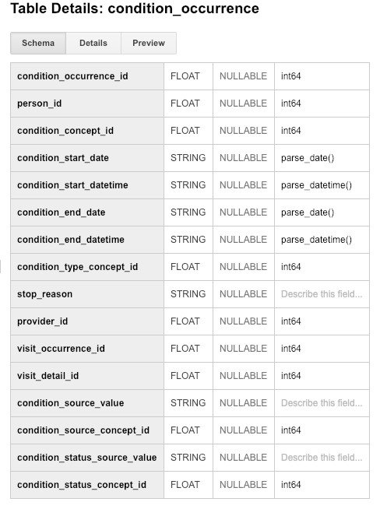
Step 1: Understand source/target data models
CONDITION_OCCURRENCE is the TARGET OMOP table.
Read the OMOP documentation about the type of data stored in CONDITION_OCCURRENCE and for three fields below that are in that table:
person_id
visit_occurrence_id
condition_source_value
Notes:
Paste into one or more slides, the key table or tables from MIMIC that hold data that can be used to fill in the OMOP CONDITION_OCCURRENCE table.
Choose the MIMIC table screenshots from this slide to indicate which MIMIC table or tables would be used in the ETL process. Delete the MIMIC tables that you will not use.

Slide 4
Step 1: Understand source/target data models
CONDITION_OCCURRENCE is the TARGET OMOP table.
Select one or more MIMIC tables from the table screen shots on the next slides that you feel are most related to the three fields in CONDITION_OCCURRENCE.
Notes:
Paste into one or more slides, the key table or tables from MIMIC that hold data that can be used to fill in the OMOP CONDITION_OCCURRENCE table.
Choose the MIMIC table screenshots from this slide to indicate which MIMIC table or tables would be used in the ETL process. Delete the MIMIC tables that you will not use.

Slide 5
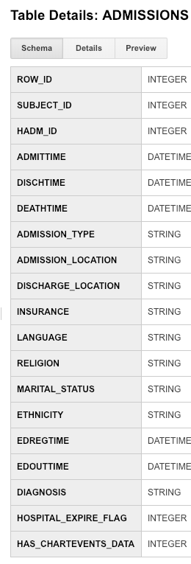
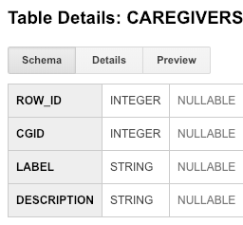
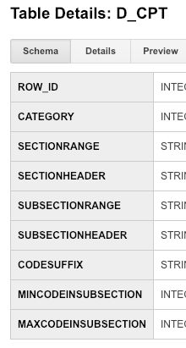
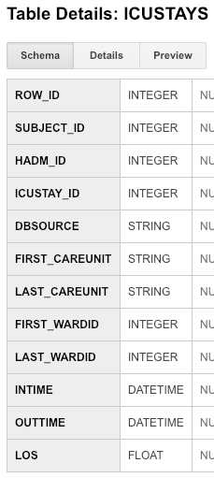
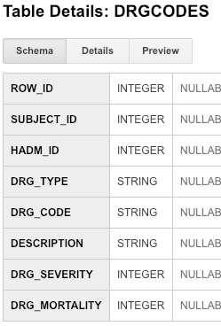
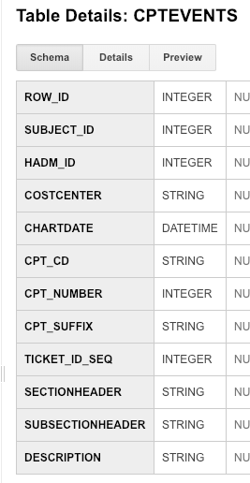
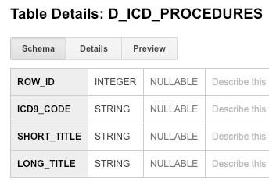
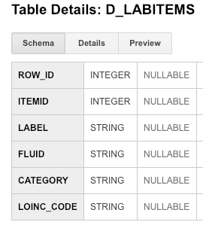
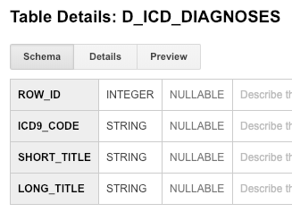
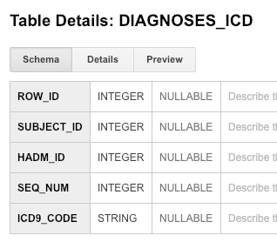
Use these screen captures (and next slide) to select one or more MIMIC tables that contain data for OMOP CONDITION_OCCURRENCE table
Notes:
Paste into one or more slides, the key table or tables from MIMIC that hold data that can be used to fill in the OMOP CONDITION_OCCURRENCE table.
Choose the MIMIC table screenshots from this slide to indicate which MIMIC table or tables would be used in the ETL process. Delete the MIMIC tables that you will not use.

Slide 6
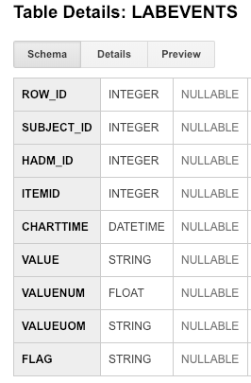
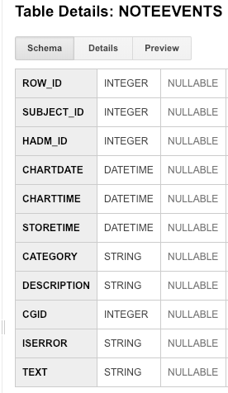
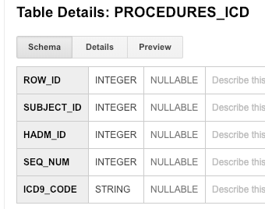
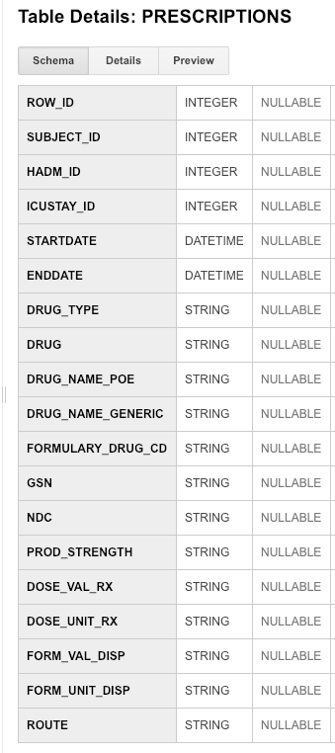
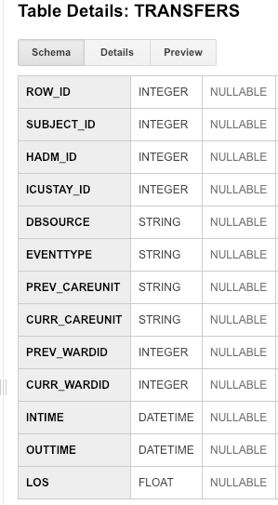
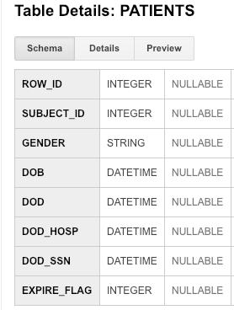
Use these screen captures (and previous slide) to select one or more MIMIC tables that contain data for OMOP CONDITION_OCCURRENCE table
Notes:
Paste into one or more slides, the key table or tables from MIMIC that hold data that can be used to fill in the OMOP CONDITION_OCCURRENCE table.
Choose the MIMIC table screenshots from this slide to indicate which MIMIC table or tables would be used in the ETL process. Delete the MIMIC tables that you will not use.

Slide 7
Assignment 1
MIMIC tables
OMOP CONDITION_OCCURRENCE table

Slide 8
Step 1: Understand source/target data models
Paste one or more MIMIC table(s) from the previous two slides that contain data for ETL into OMOP CONDITION_OCCURRENCE here!
Notes:
Paste into one or more slides, the key table or tables from MIMIC that hold data that can be used to fill in the OMOP CONDITION_OCCURRENCE table.
Choose the MIMIC table screenshots from this slide to indicate which MIMIC table or tables would be used in the ETL process. Delete the MIMIC tables that you will not use.

Slide 9
Assignment 2
MIMIC tables

Slide 10
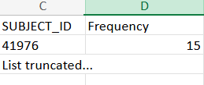
Step 2: Profile source table or tables
Using the White Rabbit profiling data from the 100 patient MIMIC database provided in the Assessment to comment on the distribution of the SUBJECT_ID field from one of the MIMIC tables selected in Step 1
MIMIC ADMISSIONS
Assignment 3
Notes:
Use the White Rabbit data profiling Excel spreadsheet that is linked to the assignment to describe key profiling findings from the table or tables you identified in ETL Step 1. See rubric for the types of topics to include here.

Slide 11
Step 3: Create ETL mappings
Assignment 4
MIMIC PATIENTS
Field 1
Field 2
SUBJECT_ID
Field 4
Field 5
Field 6
Field 7
Field 8
The ‘Patient_id’ from OMOP CONDITION_OCCURENCE table is mapped to ‘SUBJECT_ID’ from the MIMIC PATIENTS Table
Notes:
For each MIMIC table or tables (one table per slide) from Step 1, paste the screenshot of the MIMIC table on left side. Show field mappings from the MIMIC table to the OMOP CONDITION_OCCURRENCE table using arrows. Only provide mappings to the OMOP person_id, visit_occurrence_id, and condition_source_value. One MIMIC table may provide a mapping to all three OMOP tables as shown here.
Provide an explanation for each mapping why the MIMIC field relates to the OMOP field you selected on the slide

Slide 12
Step 3: Create ETL mappings
Assignment 4
MIMIC D_ICD_DIAGNOSES
Field 1
Field 2
Field 3
Field 4
ICD9_CODE
Field 6
Field 7
Field 8
The ‘condition_source_value’ from OMOP CONDITION_OCCURENCE table is mapped to ‘ICD9_CODE’ from the MIMIC PATIENTS Table
Notes:
For each MIMIC table or tables (one table per slide) from Step 1, paste the screenshot of the MIMIC table on left side. Show field mappings from the MIMIC table to the OMOP CONDITION_OCCURRENCE table using arrows. Only provide mappings to the OMOP person_id, visit_occurrence_id, and condition_source_value. One MIMIC table may provide a mapping to all three OMOP tables as shown here.
Provide an explanation for each mapping why the MIMIC field relates to the OMOP field you selected on the slide

Slide 13
Step 3: Create ETL mappings
Assignment 4
MIMIC ADMISSIONS
Field 1
Field 2
Field 3
Field 4
Field 5
Field 6
Field 7
HADM_ID
The ‘visit_occurrence_id’ from OMOP CONDITION_OCCURENCE table is mapped to ‘HADM_ID’ from the MIMIC PATIENTS Table
Notes:
For each MIMIC table or tables (one table per slide) from Step 1, paste the screenshot of the MIMIC table on left side. Show field mappings from the MIMIC table to the OMOP CONDITION_OCCURRENCE table using arrows. Only provide mappings to the OMOP person_id, visit_occurrence_id, and condition_source_value. One MIMIC table may provide a mapping to all three OMOP tables as shown here.
Provide an explanation for each mapping why the MIMIC field relates to the OMOP field you selected on the slide

Slide 14
Step 4: Write transformation code
WITH person1 as (select distinct mp.subject_id as person_id,
mp.subject_id as person_source_value from mimic3_demo.PATIENTS mp),
person2 as (select distinct p1.person_id, p1.person_source_value
,mp.GENDER as gender_source_value
,CASE mp.GENDER
WHEN 'F' then 8532
WHEN 'M' then 8507
ELSE 0 END as gender_concept_id
from person1 p1 join mimic3_demo.PATIENTS mp on p1.person_id = mp.subject_id),
person3 as (select distinct p2.person_id, p2.person_source_value
,p2.gender_source_value, p2.gender_concept_id
,extract(year from mp.dob) as year_of_birth
,extract(month from mp.dob) as month_of_birth
,extract(day from mp.dob) as day_of_birth
,dob as birth_datetime
from person2 p2 join mimic3_demo.PATIENTS mp on p2.person_id = mp.subject_id),
person4 as (select distinct p3.person_id, p3.person_source_value
,p3.gender_source_value,p3.gender_concept_id
,p3.year_of_birth, p3.month_of_birth, p3.day_of_birth, p3.birth_datetime
,ma.ethnicity as race_source_value
,case ma.ethnicity
when 'WHITE' then 8527
when 'BLACK/AFRICAN AMERICAN' then 8516
when 'ASIAN' then 8515
when 'HISPANIC/LATINO-PUERTO RICAN' then 44814653
when 'HISPANIC OR LATINO' then 44814653
when 'UNKNOWN/NOT SPECIFIED' then 44814653
when 'OTHER' then 44814653
when 'AMERICAN INDIAN/ALASKA NATIVE FEDERALLY RECOGNIZED TRIBE' then 8657
when 'UNABLE TO OBTAIN' then 44814650
else 0 end as race_concept_id
from person3 p3 join mimic3_demo.ADMISSIONS ma on p3.person_id = ma.subject_id),
person as (select distinct p4.person_id, p4.person_source_value
,p4.gender_source_value,p4.gender_concept_id
,p4.year_of_birth, p4.month_of_birth, p4.day_of_birth, p4.birth_datetime
,p4.race_source_value, p4.race_concept_id
,ethnicity as ethnicity_source_value
,case ma.ethnicity
when 'WHITE' then 38003564
when 'BLACK/AFRICAN AMERICAN' then 38003564
when 'ASIAN' then 38003564
when 'HISPANIC/LATINO-PUERTO RICAN' then 38003563
when 'HISPANIC OR LATINO' then 38003563
when 'UNKNOWN/NOT SPECIFIED' then 44814653
when 'OTHER' then 38003564
when 'AMERICAN INDIAN/ALASKA NATIVE FEDERALLY RECOGNIZED TRIBE' then 38003564
when 'UNABLE TO OBTAIN' then 44814650
else 0 end as ethnicity_concept_id
from person4 p4 join mimic3_demo.ADMISSIONS ma on p4.person_id = ma.subject_id)
select * from person
Paste the SQL statements that transform data from one or more MIMIC tables into the three OMOP CONDITION_OCCURRENCE fields (patient-id, visit_occurrence_id, condition_source_value) into the Coursera Submission Site
Transformation code shown here is from the Course 2 videos showing transformation of MIMIC PATIENTS to OMOP PERSON
Notes:
Paste the SQL statements that transform data in one or more MIMIC tables to the correct column or columns in OMOP CONDITION_OCCURRENCE into the Coursera Submission Site.

Slide 15
Step 5: Execute transformation code
Execute the ETL code from Step 4 but do not submit the output table.
Use the output table for Step 6.
There is no submission for this Step.
Notes:
Execute the ETL code from Step 4 but do not submit output table. Use output table for Step 6.
There is no submission for this Step.

Slide 16
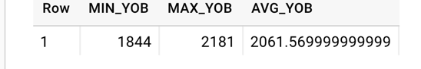
Step 6: Perform data quality assessment
Define, implement, execute one or more data quality measures.
Submit final DQ measure and an explanation why you created your measure(s).
Example output table from the Course 2 videos showing transformation of MIMIC PATIENTS to OMOP PERSON
OK to paste link to a GoogleDoc instead.
Notes:
Paste the output from your data quality SQL executed on the OMOP CONDITION_OCCURRENCE table generated in Step 5 into this slide.
OK to paste link to a GoogleDoc instead.

Slide 17
Step 7: Package documentation
Congratulations! The materials in the previous slides constitute a complete ETL package.
There is no submission for this Step.

